Slide 1
TU856-1 and TU858-1 Computer Architecture and Technology
Thursday 3 April 2025
(Week 10) Tutorial 6

Slide 2
Questions and Answers ( 1 )
Why are information technology networks so prolific?
They are useful and desirable.
In war and in industry information is power (and/or profit-generating). The military and large corporations were the first to employ networks, and they promoted their use in society.
The technology that supports networks has developed quickly, and has its own industries.

Slide 3
Questions and Answers ( 2 )
Are there many network system types (platforms)?
There are (for small computer systems, such as PCs Macs – towers and laptops), two main formats:
Windows type
Unix and Linux type
They are able to interlink, however. There are many variations on format and size.

Slide 4
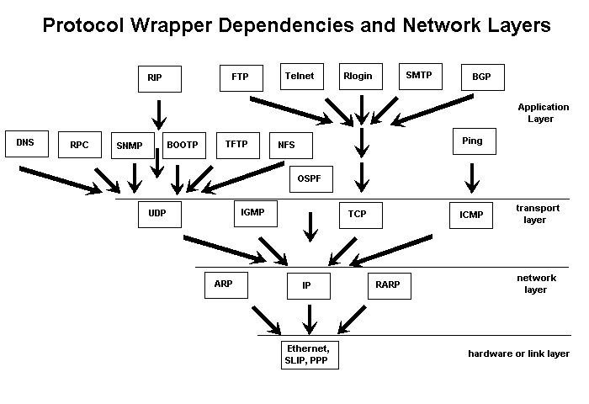
Network Acronyms
From the lecture this morning – most of these acronyms are to be found here:
https://en.wikipedia.org/wiki/List_of_information_technology_acronyms

Slide 5
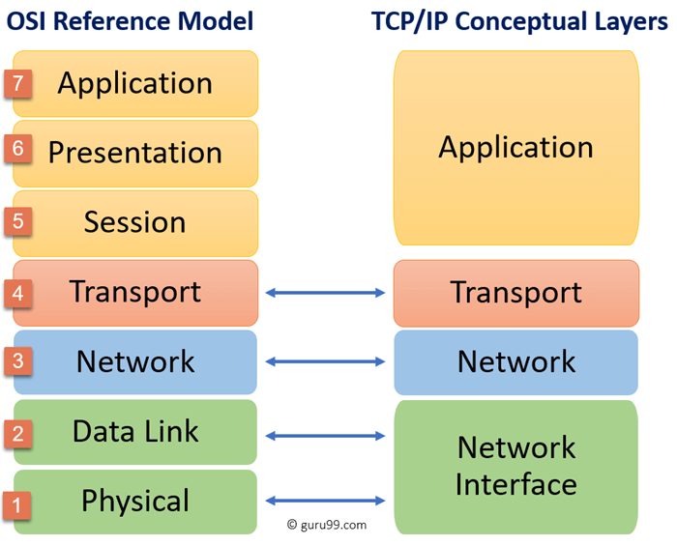

Slide 6
Networks on Youtube
My pick of Youtube clips for networks:
Introduction to networking – well explained
https://www.youtube.com/watch?v=JvXro0dzJY8
Troubleshooting tricks – command line fun
https://www.youtube.com/watch?v=AimCNTzDlVo

Slide 7
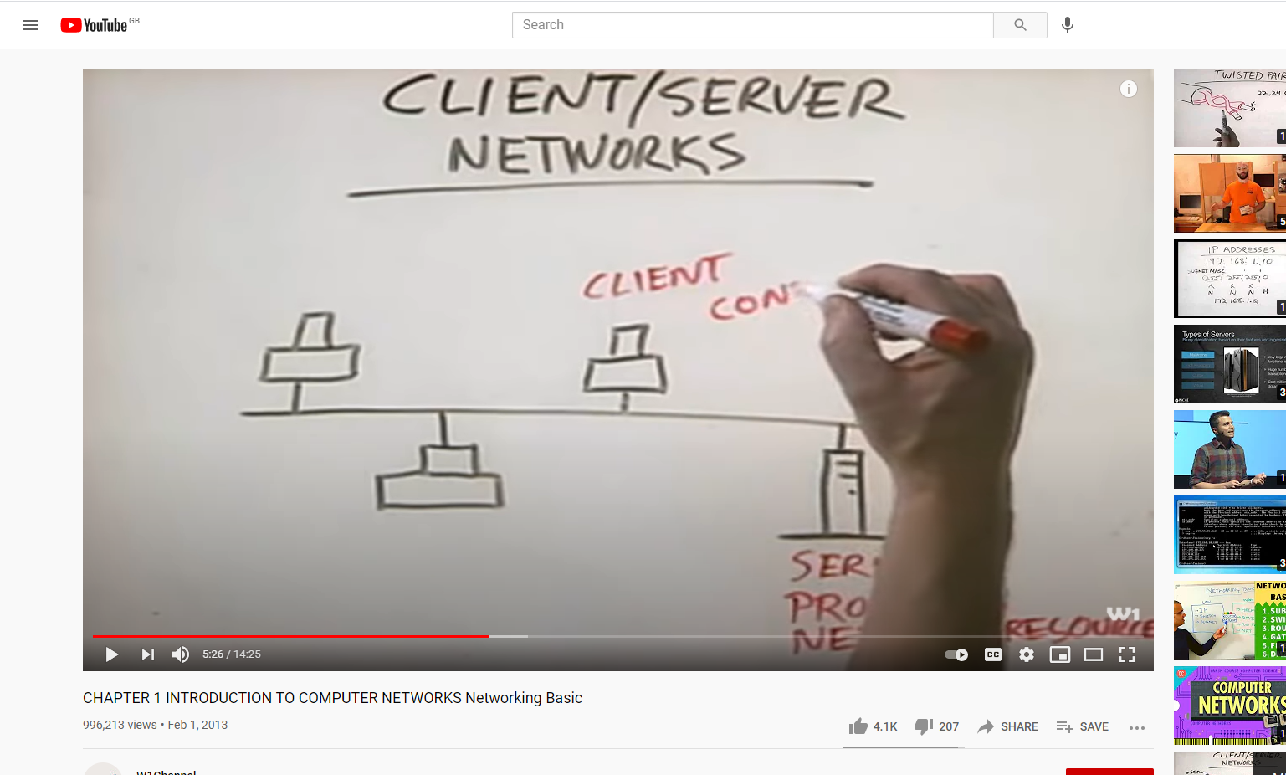
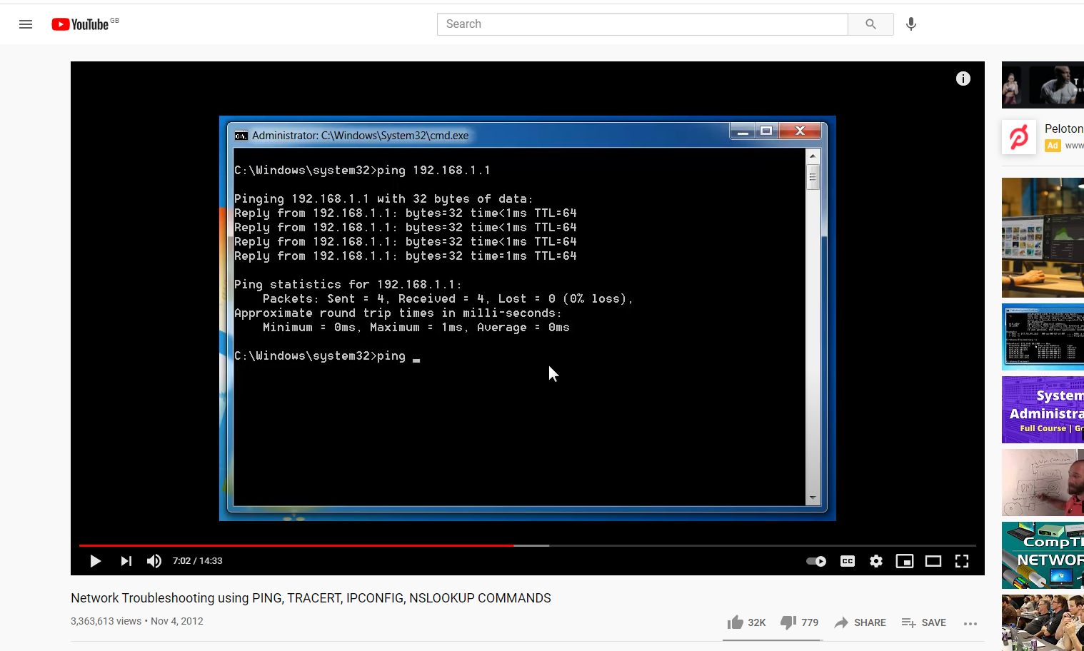
Networks on Youtube (2)
Introduction to networking
Troubleshooting tricks

Slide 8
Typical Exam (Sub) Question For This Content
Question
How do nodes on a network exchange data? Your answer should include ‘linking types’ and hardware types for network transmission options.
Sample solution
A computer network may be ‘fixed’ – i.e. connected permanently using cables - or their links might be temporary - as when connected via modems. Wireless networks generally work using waves in the air and are passed and then processed over ‘WiFi’ (Wireles Fidelity – a wireless local area network) or a proprietary carrier's networks – carriers being Eircom and ESAT BT.
Network transmission speeds, measured in bits per second, range from only a few thousand bits per second (Kbps) for old networks, to millions of bits per second (Mbps).

Slide 9
Solution continued
High-speed networks are currently operating at 100-200 Mbps (in an office of 2 - 20 computers) and ‘special’ applications of technology offer billions of bits per second (Gbps) (in a laboratory environment, perhaps).
To control the data traffic on a computer network the method of switching is used. There are two main switching methods for networks:
Packet switching
Circuit switching
In packet-switched networks a router is a device (and/or software) in a computer that determines the next network point to which a packet should be forwarded to take it closer to its destination. The router is connected to at least two networks and decides which way to send each information packet based on the state of the networks it is connected to.

Slide 10
Solution continued
A router is located at a gateway - the hardware point where one network meets another.
Network transmission media generally fall into one of the following groups:
Copper wire - carries electrical signals, much like telephone or cable TV wiring.
Optical fibre - carries light-waves, either from lasers or Light Emitting Diodes.
Wireless - radio signals or infra-red light pulses.
(10 marks)

